Slide 1

(DAT501) Sociology: Theory and Methods
Weeks 3: Individuals and Structures
Amine Sijilmassi
amine.sijilmassi@um6p.ma

Slide 2
I) The debates we won’t address
A) Determinism vs. Contingency
B) Objectivism vs. Subjectivism
C) Holism vs. Individualism
II) The Cultural and the Agentic
A) Workshop: Social class and behavior. The case of education.
B) « Cultural » and « Agentic » schools of thought
C) Limitations of both approaches

Slide 3
I) The debates we won’t address
A) Determinism vs. Contingency
B) Objectivism vs. Subjectivism
C) Holism vs. Individualism

Slide 4
Determinism vs. contingence
Debate: Are social agents strictly determined by the structure in which they are, or is there room for contingence or personal agency within these structures?

Slide 5
Traditionally, sociology leans deterministic

Slide 6
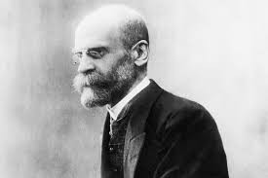
A typically holistic paradigm: Durkheimian social facts
Les Règles de la méthode sociologique (1894)
Sociology is the science of “social facts”:
Social facts = “manières d’agir, de penser et de sentir, qui sont extérieures à l’individu, et qui sont dotées d’un pouvoir de coercition en vertu du quel elles s’imposent à lui”
Example: Eating with a fork instead of your hands

Slide 7
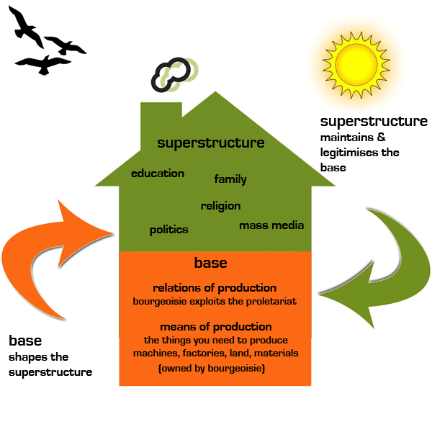
Marxism

Slide 8
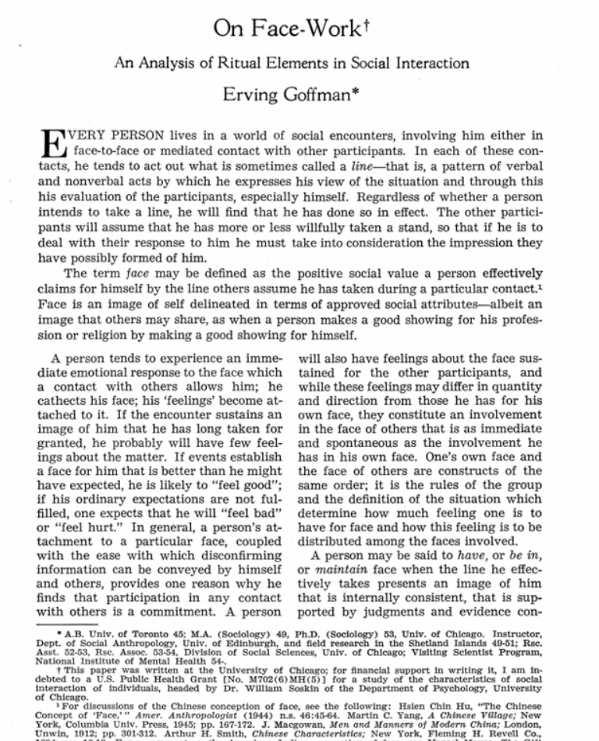

Other approaches lean more towards symbolic interactionism

Slide 9

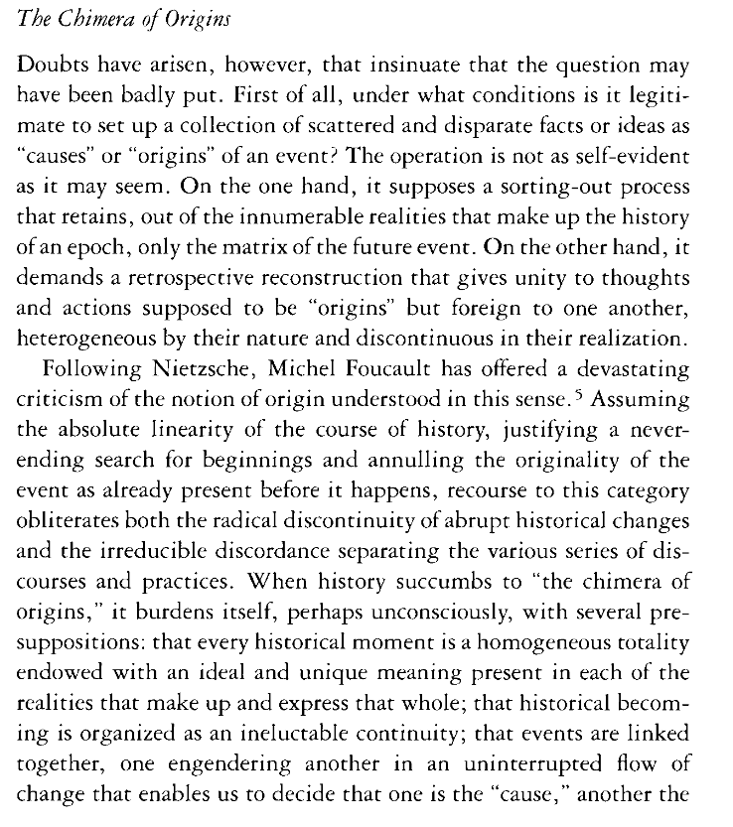
This debate is perhaps most pronounced in history

Slide 10
Today I would say that most history leans towards an emphasis on contingence rather than causal laws to understand historical change

Slide 11



Slide 12
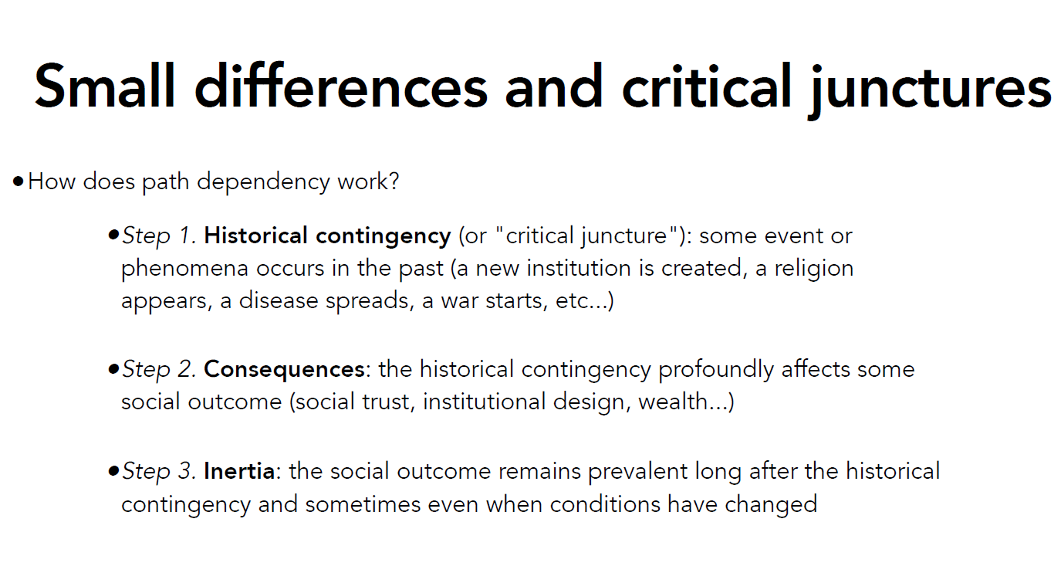

Slide 13
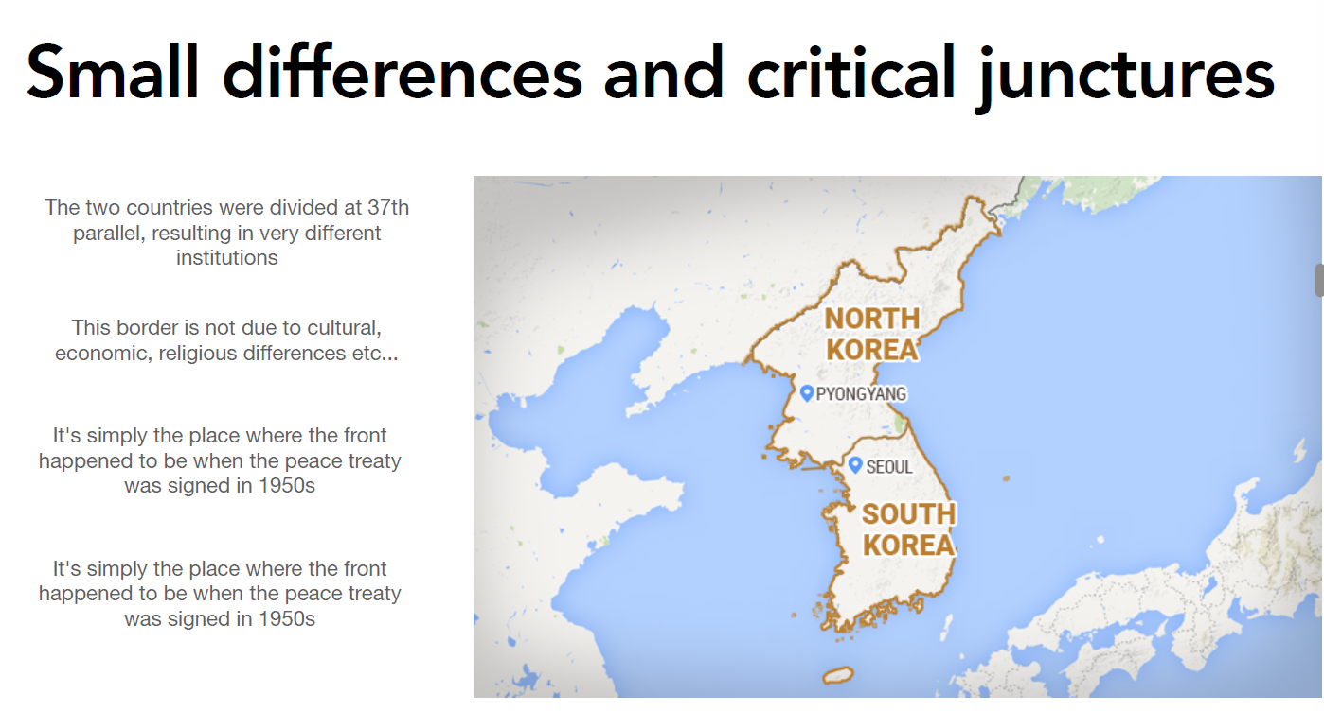

Slide 14
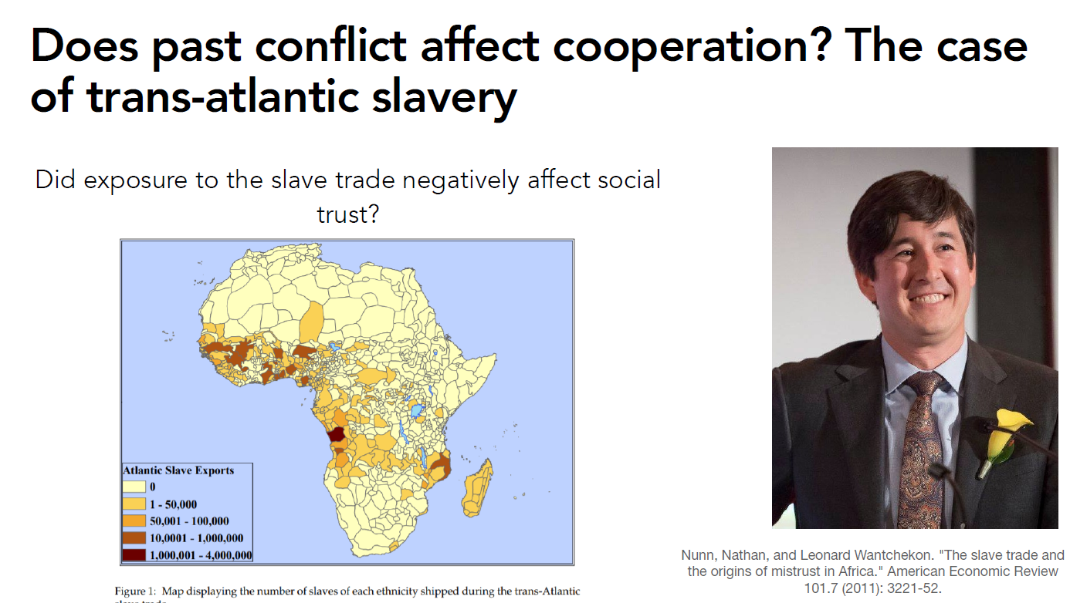

Slide 15
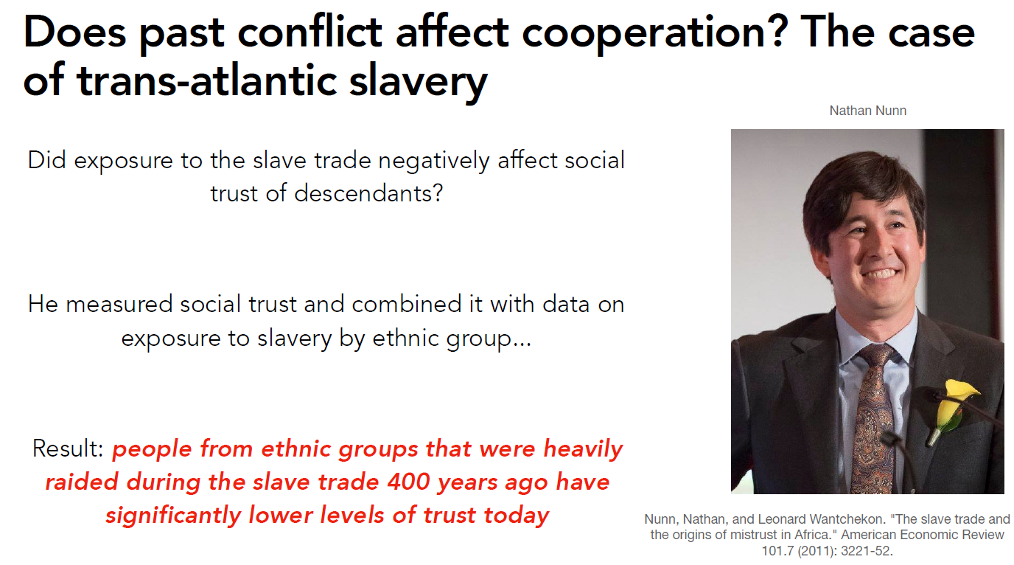

Slide 16
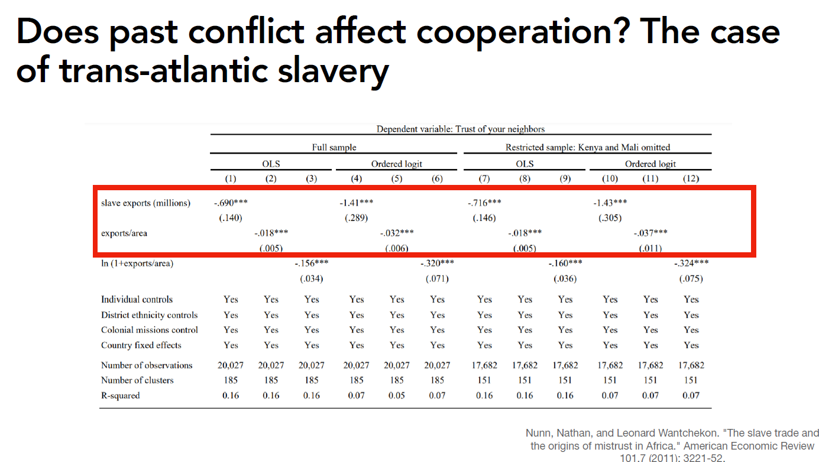

Slide 17
Overall…
Debate: Are social agents strictly determined by the structure in which they are, or is there room for contingence or personal agency within these structures?
Not so important, because most people agree on something like « probabilistic determinism »
Most people agree that structural constraints play a role… including RCT and other approaches with a reputation to be « agentic »!
RCT is also « deterministic »: individuals are assumed to be predictible and to react predictibly to external constraints (e.g. prices, quality of products, available options…)

Slide 18
I) The debates we won’t address
A) Determinism vs. Contingency
B) Objectivism vs. Subjectivism
C) Holism vs. Individualism

Slide 19
Objectivism vs. subjectivism
Debate: Is society an objective reality that can be studied scientifically, or does it only exist through the eyes of the individuals who give it meaning?

Slide 20
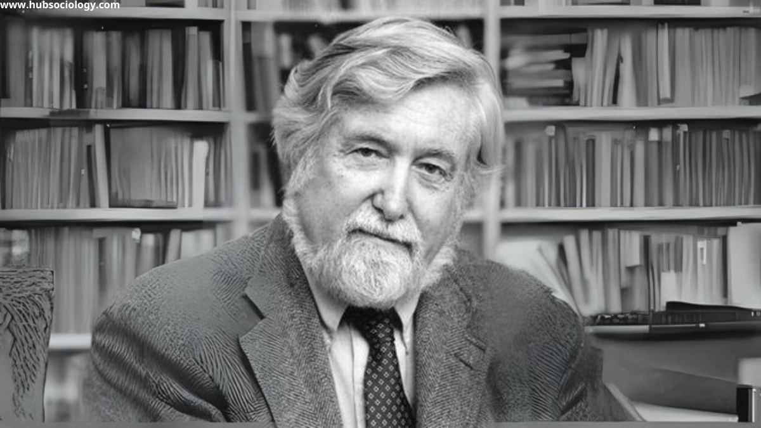
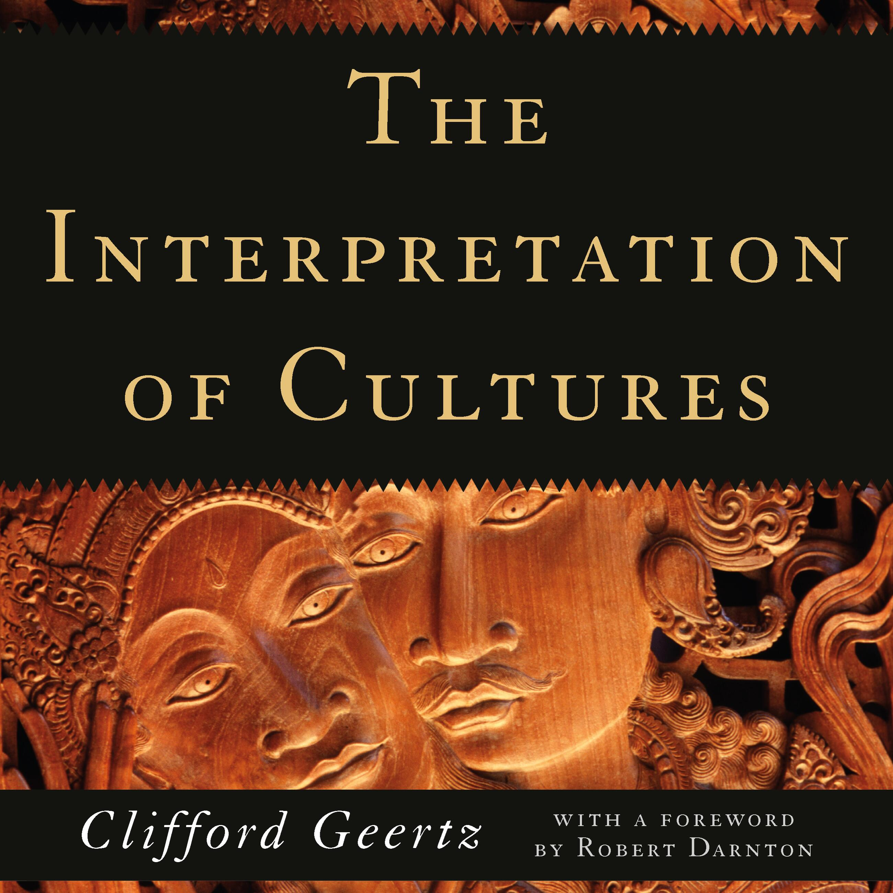
« The interpretive turn »
“man is an animal suspended in webs of significance he himself has spun, I take culture to be those webs”
‘Thick description”: the task of the social scientist is to describe social interactions in a thick way, to reconstruct the deep subjective meaning of every aspect of the interaction

Slide 21
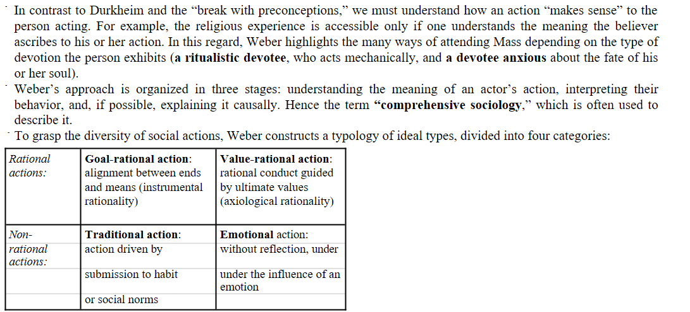
Max Weber has this reputation also

Slide 22
Objectivism vs. subjectivism
Debate: Is society an objective reality that can be studied scientifically, or does it only exist through the eyes of the individuals who give it meaning?
In the second case, raises the question if this is even still « science »
Most social scientists today recognize that objective features outside of individual minds do play a role in their actions and behaviors (even while recognizing the importance of considering subjectivity)
Moving past this debate is one of the reason Pierre Bourdieu is so important: « habitus » is « social incorporé »: it’s an objective reality (like, one’s objective position in society) that shapes a subjective life (e.g. my tastes, my mannerisms, my relationship with my body, etc…)

Slide 23
Les conditionnements associés à une classe particulière de conditions d’existence produisent des habitus, systèmes de dispositions durables et transposables, structures structurées prédisposées à fonctionner comme structures structurantes, c'est-à-dire en tant que principes générateurs et organisateurs de pratiques et de représentations qui peuvent être objectivement adaptées à leur but sans supposer la visée consciente des fins et la maîtrise expresse des opérations nécessaires pour les atteindre, objectivement « réglées » et « régulières » sans être en rien le produit de l’obéissance à des règles, et, étant tout cela, collectivement orchestrées sans être le produit de l’action organisatrice d’un chef d’orchestre.
Pierre Bourdieu, Le Sens pratique, Paris, Les Éditions de minuit, 1980, 480 p. (ISBN 978-2-7073-0298-4), p. 88

Slide 24
I) The debates we won’t address
A) Determinism vs. Contingency
B) Objectivism vs. Subjectivism
C) Holism vs. Individualism

Slide 25


‘Holism vs. Individualism’
Debate: Is society an objective reality outside of individuals that exerts its influence on individuals (holism), or the product of individual actions (individualism)

Slide 26
A typically holistic paradigm: Durkheimian social facts
Les Règles de la méthode sociologique (1894)
Sociology is the science of “social facts”:
Social facts = “manières d’agir, de penser et de sentir, qui sont extérieures à l’individu, et qui sont dotées d’un pouvoir de coercition en vertu du quel elles s’imposent à lui”
Example: Eating with a fork instead of your hands

Slide 27
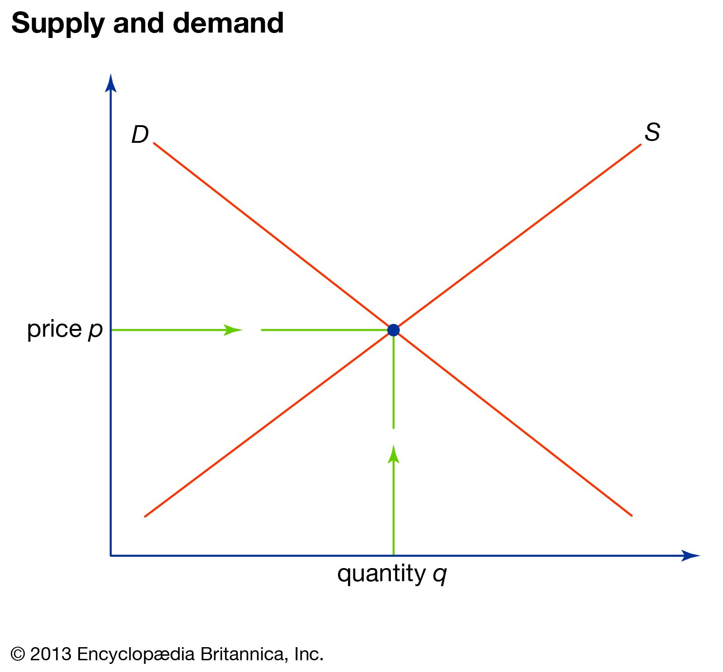
Typical « individualist approach »: in economy
Prices are a macro phenomenon that result purely from the aggregation of individual behavior!
(NB: it doesn’t keep it from influencing individual behavior in return)

Slide 28

Durkheim’s critique of individualistic explanations: division of labor
The increased division of labor in society comes from individual self-interest: we all benefit from specializing on specific tasks to be more productive, earn more money etc….
But for Durkheim: the division of labor is not caused by individual wills, but my macrostructural (“social”) mutations: the “hausse de la densité morale et matérielle” (increased population and interactions) that requires a separation of tasks for it to work

Slide 29

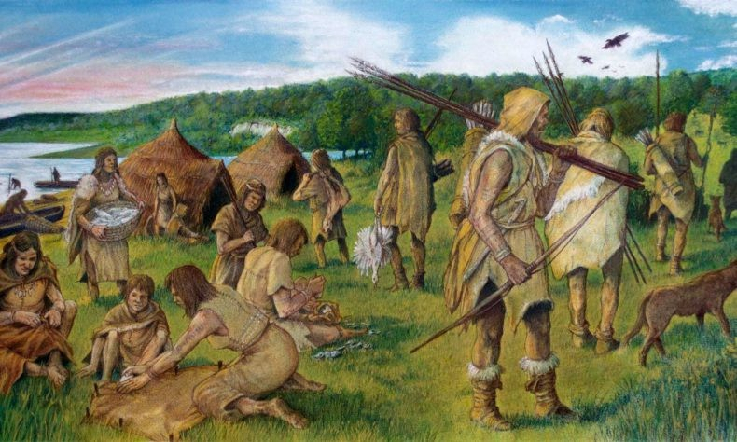

Organic & Mechanical Solidarity
Durkheim wanted to capture the intuition that there is a distinction between "traditional" societies and modern, industrial ones
"Traditional societies"
"Modern societies"
vs.
1893

Slide 30
Organic & Mechanical Solidarity
Mechanical solidarity = a society where the cohesion results from the homogeneity of its members.
  Cohesion comes from the fact that individuals are culturally very similar, do very similar activities ( no "task specialization"), and share strong collective norms
Organic solidarity = a society where the cohesion results from the
complementarity of its members.
  Cohesion comes from the fact that individuals are highly interdependent, due to a high "division of labor". Thus, social solidarity can be maintained even in a society where people are less similar, do different activities, are not regulated by strong shared norms etc...
1893

Slide 31
Even « individualists » recognize the possibility of « emergence »
Emergence: when complex entity, system, or organism possesses properties, behaviors, or patterns that its individual parts do not have on their own
Schelling (1971)’s model of segregation: very small individual preferences for discrimination can result in massive segregation at the macro scale!
https://www.youtube.com/watch?v=tsOOeQ9IxvA
Schelling, T. C. (1971). Dynamic models of segregation. The Journal of Mathematical Sociology, 1(2), 143–186. https://doi.org/10.1080/0022250X.1971.9989794

Slide 32
Overall…
Debate: Is society an objective reality outside of individuals that exerts its influence on individuals (holism), or the product of individual actions (individualism)?
Not so important, because most people agree that society is an external force on individuals (no one chose to eat with a fork, or to learn their native tongue…); but also that society is the product of individual actions (it didn’t fall from the sky out of nowhere)
Most people agree that emergence can occur
What varies is the emphasis: some people to start with « society », others with « individuals »

Slide 33
II) The Cultural and the Agentic
A) Workshop: Social class and behavior. The case of education.
B) « Cultural » and « Agentic » schools of thought
C) Limitations of both approaches

Slide 34
Questions you may think about while reading:
Why do these two approaches « feel » different?
Are these approaches incompatible?
Do you prefer one approach over the other? Why?
What evidence would allow us to determine whether one approach is better than the other?

Slide 35
Debate: Are individuals passive executers of interiorized norms and culture (‘cultural idiots’) or are they strategic agents who adapt their behavior to achieve their objectives?

Slide 36
II) The Cultural and the Agentic
A) Workshop: Social class and behavior. The case of education.
B) « Cultural » and « Agentic » schools of thought
C) Limitations of both approaches

Slide 37

The common assumptions of “cultural” models
Individual
Culture of the
group/society
Interiorized values, norms, preferences, habits, etc.
Values, norms, beliefs, preferences, habits, tools, etc.
Socialization
Cognitive
mechanisms for
Behavior

Slide 38
Emile Durkheim and the birth of sociology
Les Règles de la méthode sociologique (1894)
Sociology is the science of “social facts”:
Social facts = “manières d’agir, de penser et de sentir, qui sont extérieures à l’individu, et qui sont dotées d’un pouvoir de coercition en vertu du quel elles s’imposent à lui”
Example: Eating with a fork instead of your hands

Slide 39
Emile Durkheim and the birth of sociology
Les Règles de la méthode sociologique (1894)
Sociology is the science of “social facts”:
Social facts are internalized by social control
➡ formal social control. Ex: punishment by the law
➡ informal social control. Ex: disapproval from others

Slide 40
Emile Durkheim and the birth of sociology
Les Règles de la méthode sociologique (1894
Social facts cannot be explained by psychology. One must “explain the social by the social”
“La cause déterminante d'un fait social doit être cherchée parmi les faits sociaux antécédents, et non parmi les états de la conscience individuelle.”
):

Slide 41

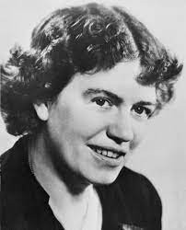
Culturalism in anthropology
An important “school of thought” in anthropology in the first half of the 20th century
Culture and socialization shape the personality
of individuals
  Individuals of a same culture share a common “basic personality”, because they are socialized to exhibit this behavior
  Different culture have different cultural “personalities”, because of these differences in socialization
Ruth Benedict Margaret Mead

Slide 42
Culturalism in anthropology
An important “school of thought” in anthropology in the first half of the 20th century
Example: Benedict, Patterns of culture (1934):
➡ The Zuni people have an Apollonian personality i.e. they are calm, reserved and controlled: "Whether it is anger or love or jealousy or grief, moderation is the first virtue. The fundamental tabu upon their holy men during their periods of office is against any suspicion of anger. Controversies (...) are carried out with an unparalleled lack of vehemence."
➡ The Kwakiutl people are exuberant, enjoy excess and breaking sensory
Ruth Benedict Margaret Mead
boundaries: "They valued all violent experience, all means by which human beings may break through the usual sensory routine, and to all such experiences they attributed the highest value".

Slide 43
II) The Cultural and the Agentic
A) Workshop: Social class and behavior. The case of education.
B) « Cultural » and « Agentic » schools of thought
C) Limitations of both approaches

Slide 44
The agentic approach:
Explains why a lot of behaviors have some degree of rationality
Very good at explaining rapid changes (e.g. why people rapidly change their consumption patterns when prices change)
The cultural approach:
Explains why behavior is often automatic, interiorized, and « external »
Very good with social reproduction
But… it sometimes raises some new questions

Slide 45
1st problem: Why do norms exhibit the features that they do, and not others?

Slide 46
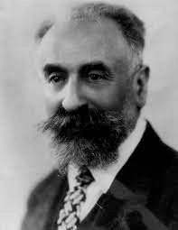
A cooperation-related social fact: the Gift in primitive societies
Essai sur le don (1924):
Across many small-scale societies, there is a strong social norm that requires individuals to “give, receive, and repay”
This is clearly a “social fact” in the Durkheimian
sense, i.e. a norm that:
➡ is external to the individual
➡ as a “coercive” force on them (not doing it is “wrong”)
Marcel Mauss (French ‘Durkheimian’ sociologist/ anthropologist)
➡ that is sanctioned by social control (not doing it leads to reputational costs)

Slide 47
A cooperation-related social fact: the Gift in primitive societies
Essai sur le don (1924):
According to Mauss, the logic of reciprocal exchange cannot be explained by atomized individuals engaging in "rational calculus".
In the societies he studies, exchanges are embedded in symbols, rituals, notions of honor and pride, religious beliefs etc... that are also "social facts" -> the Gift is a "total social fact"
Marcel Mauss (French ‘Durkheimian’ sociologist/ anthropologist)

Slide 48
« Embededness » (encastrement) of economic activities: the idea that economic exchange is not the product of decontextualized, atomized individuals pursuing self-interest, but is itself embedded into larger social structures (power relations, symbols, religious beliefs…)

Slide 49



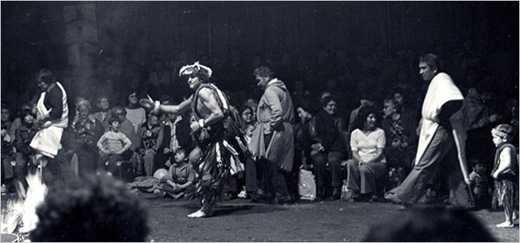
Potlatch of Northwestern America: an « agonistic » social exchange
Kula (Malinowski, 1922)

Slide 50


Slide 51
Selon Mauss, l’échange social exprime “à la fois et d'un coup toutes sortes d'institutions : religieuses, juridiques et morales - et celles-ci politiques et familiales en même temps ; économiques - et celles-ci supposent des formes particulières de la production et de la consommation, ou plutôt de la prestation et de la distribution ; sans compter les phénomènes esthétiques auxquels aboutissent ces faits et les phénomènes morphologiques que manifestent ces institutions”

Slide 52
A cooperation-related social fact: the Gift in primitive societies
But it's unclear WHY reciprocal exchange is such a major social norms, and why it is found across so many societies
Marcel Mauss (French ‘Durkheimian’ sociologist/ anthropologist)

Slide 53

(i) Reciprocity is the social norm in all human societies
Curry et al. (2019). Is it good to cooperate? Testing the theory of morality-as-cooperation in 60 societies. Current Anthropology

Slide 54
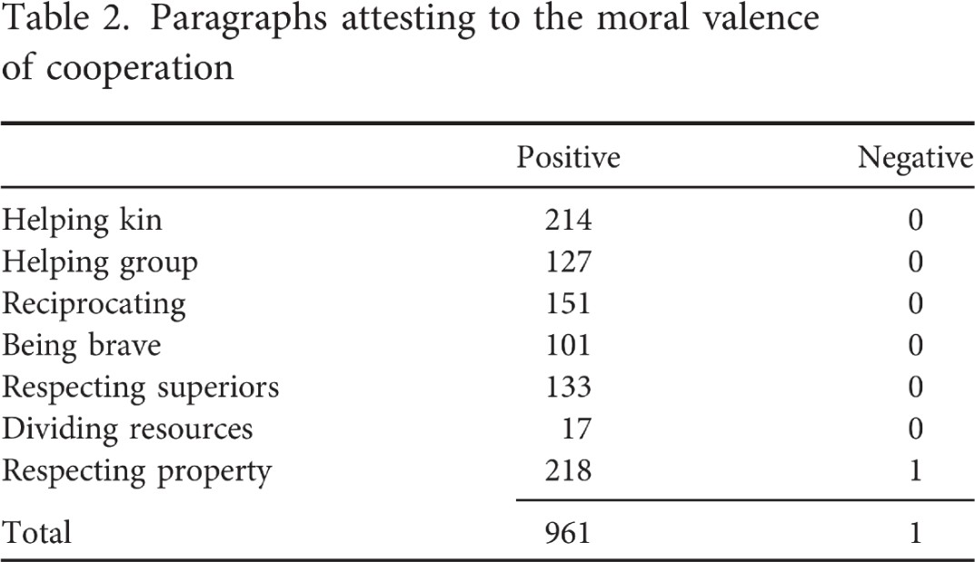
(i) Reciprocity is the social norm in all human societies
Curry et al. (2019). Is it good to cooperate? Testing the theory of morality-as-cooperation in 60 societies. Current Anthropology

Slide 55
A culturalist explanation of economic exchange needs to explain why the reciprocal don-contre don norm exists in the first place, why this norm exists instead of a different one, and why it stabilizes.

Slide 56
In the case of economic exchange, it also begs the question of why the reciprocity norm so closely tracks one of the most foundational findings of a very agentic approach: game theory!

Slide 57
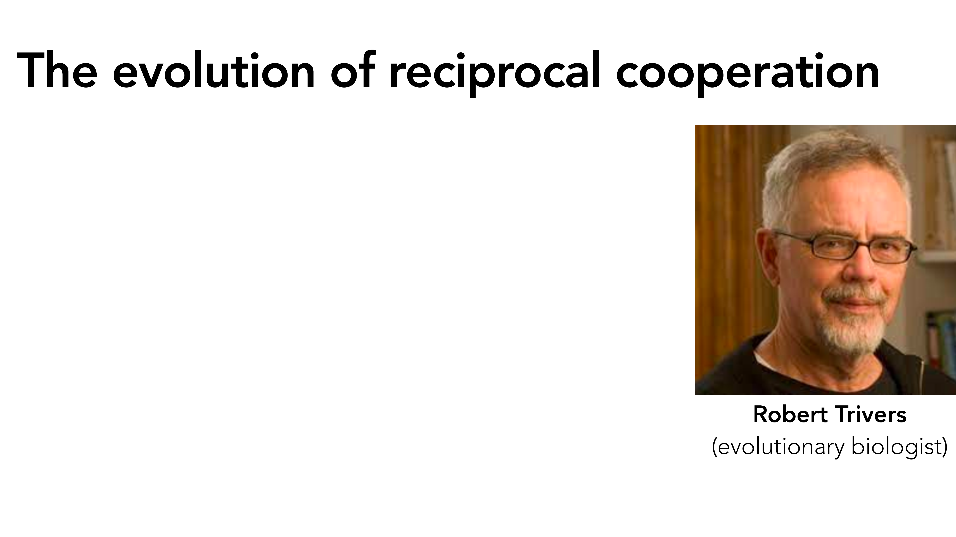

Slide 58
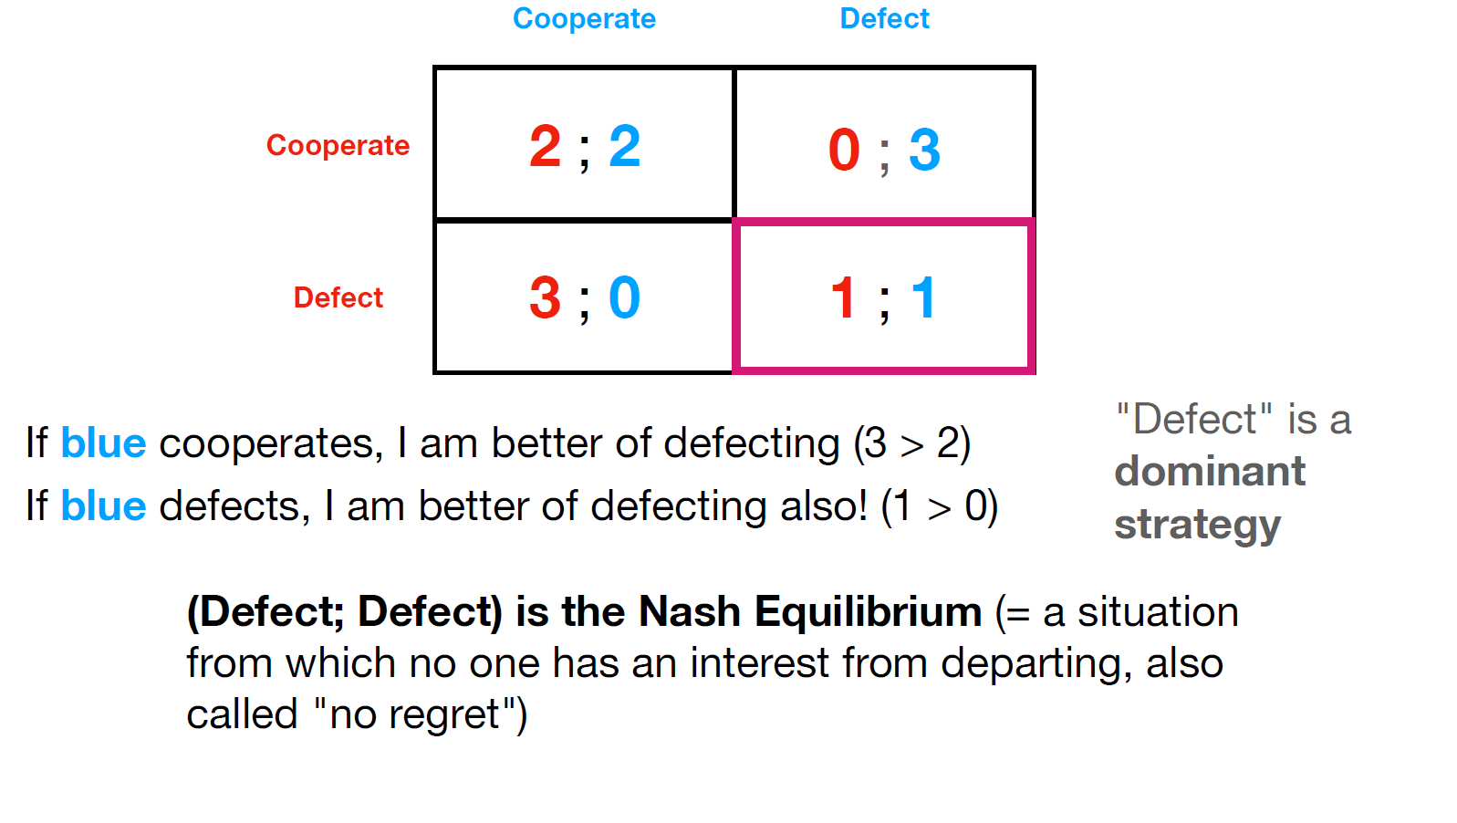

Slide 59
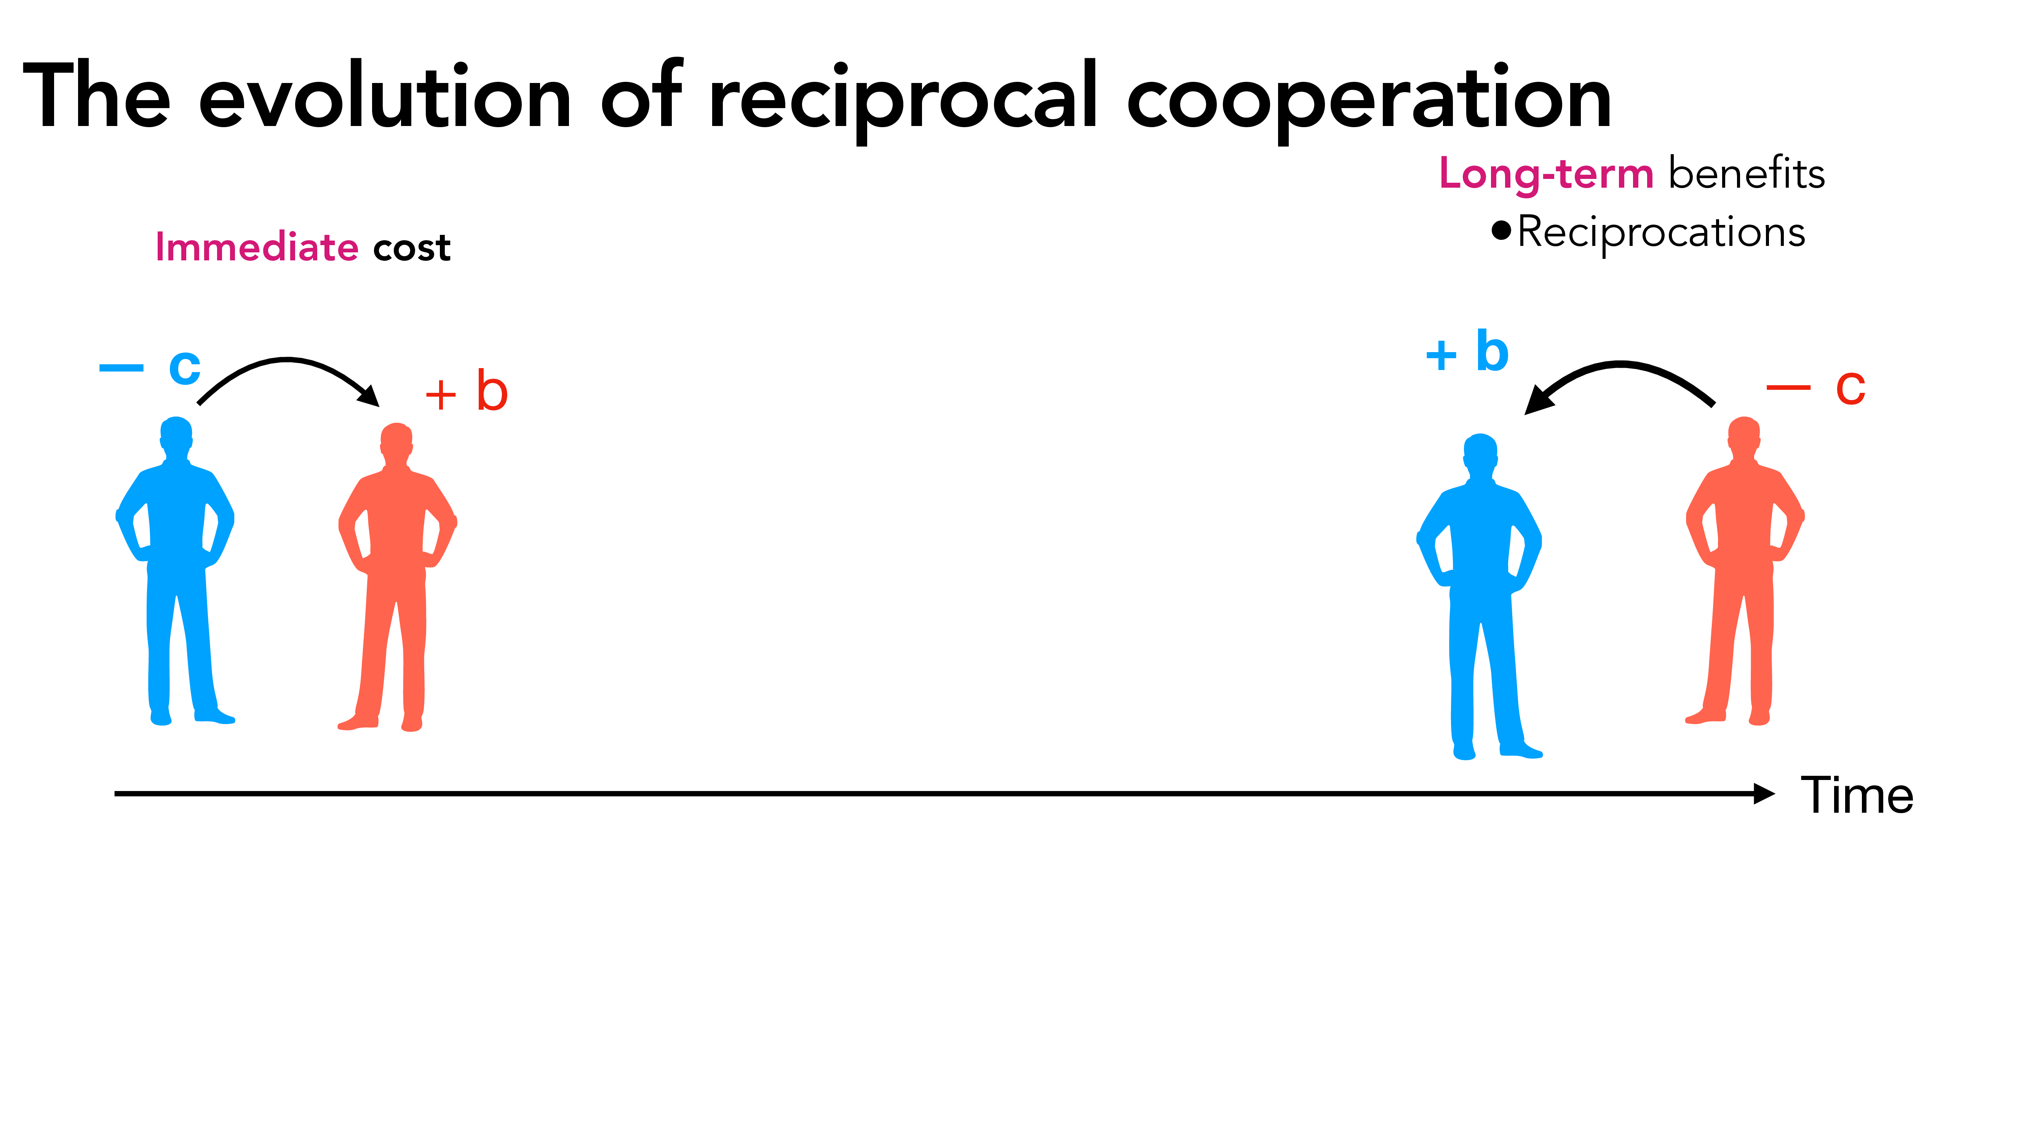

Slide 60
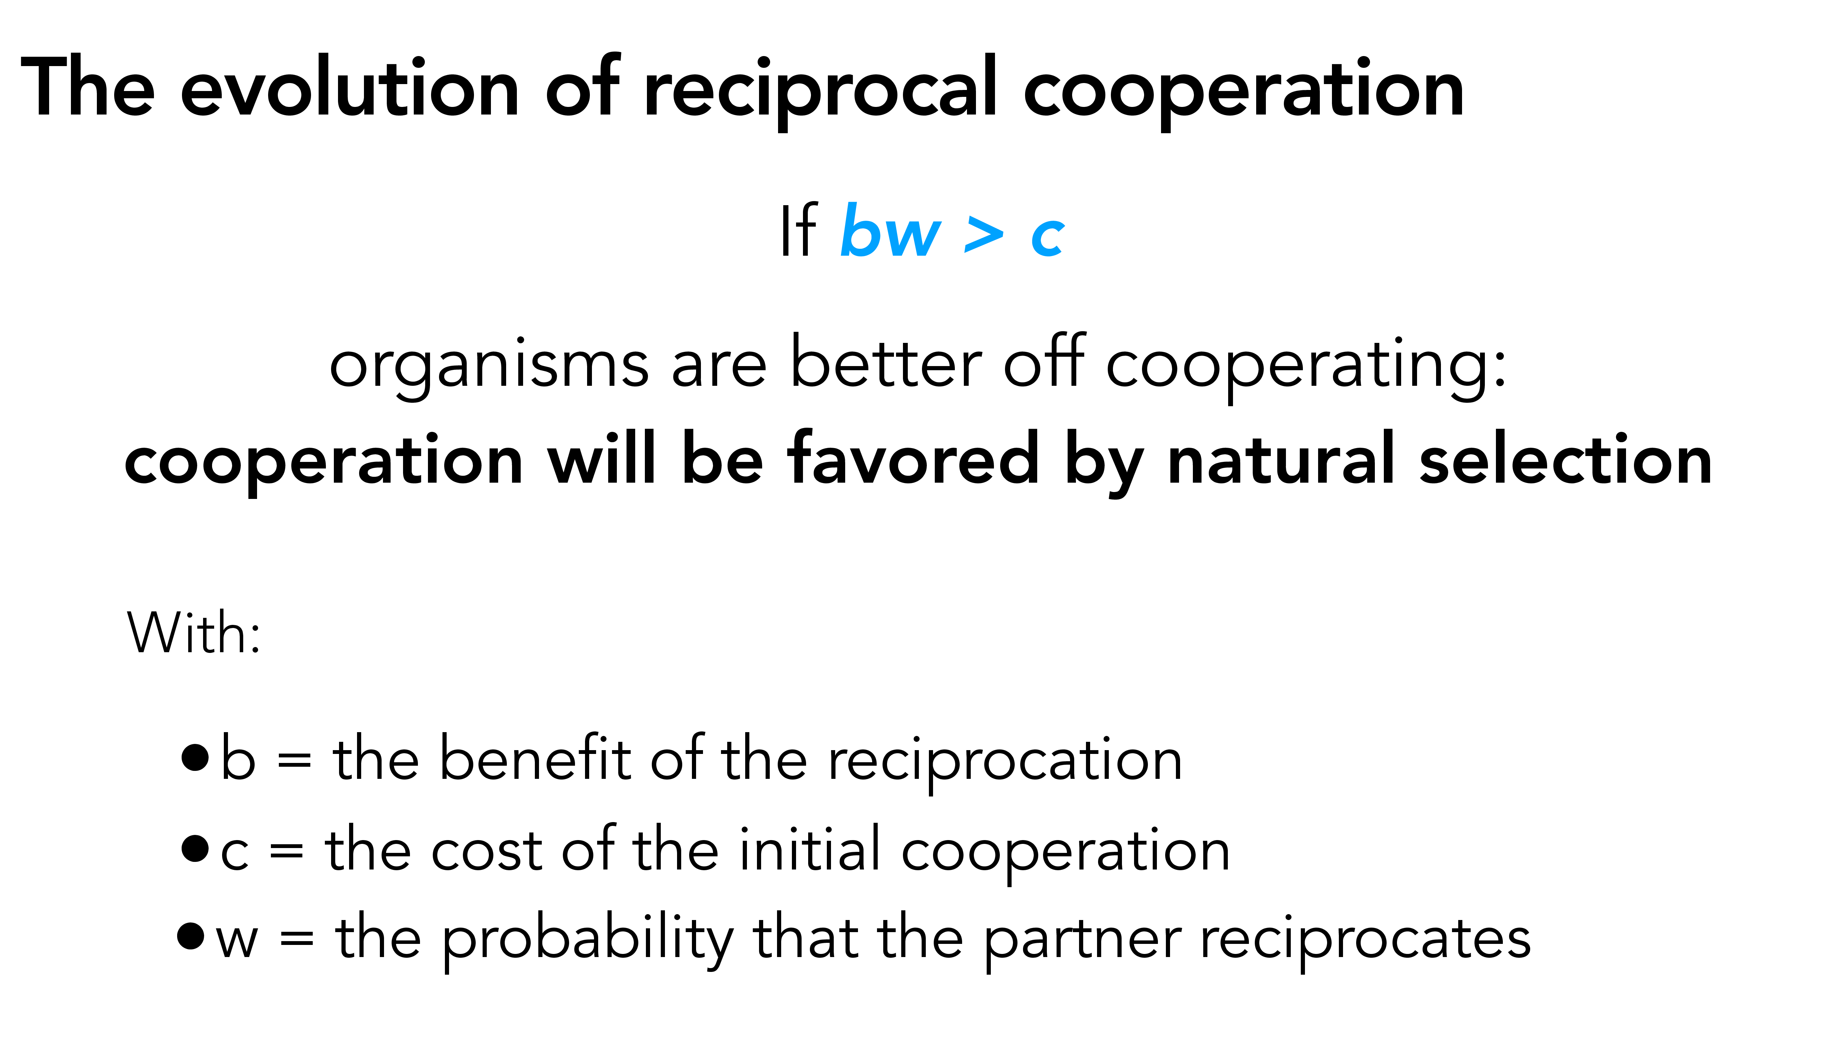

Slide 61
The prisoner’s dilemma
Standard result:
When the game is one-shot (played only once), the dominant strategy in the prisoner’s dilemma is to defect
Notes:
Note the assumption that they cannot communicate and don’t know what the other will do or wants to do.

Slide 62
And when the game is repeated?
  Standard results (Axelrod, 1984): In the iterated prisoner’s dilemma, the strategy that pays the more in the long run is:
“conditional cooperation”:
Start by cooperating, and continue to cooperate as long as the other player cooperates
Defect if the other player has defected in the previous round

Slide 63
Cooperation should take the form of a tit-for-tat strategy, or “conditional cooperation”

Slide 64


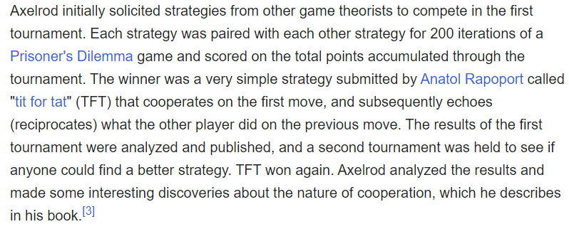

Slide 65

https://ncase.me/trust/
Next week’s short test will be on this!!!

Slide 66
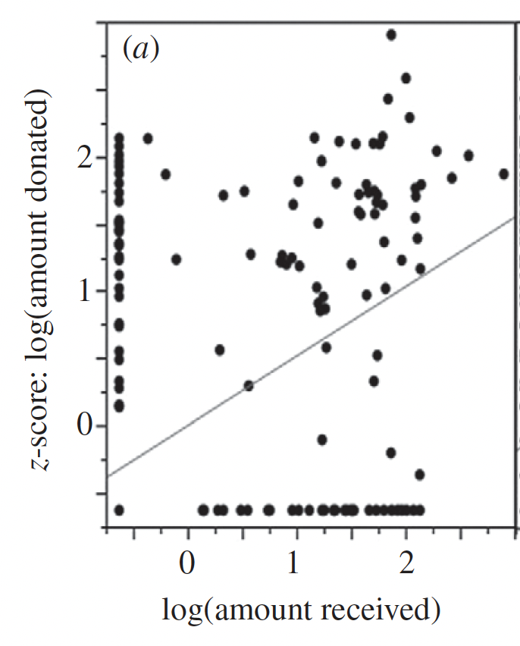
Reciprocity in nature
Carter, G. G., & Wilkinson, G. S. (2013). Food sharing in vampire bats: reciprocal help predicts donations more than relatedness or harassment. Proceedings of the Royal Society B.
Notes:
Natural selection is a competitive process

Slide 67
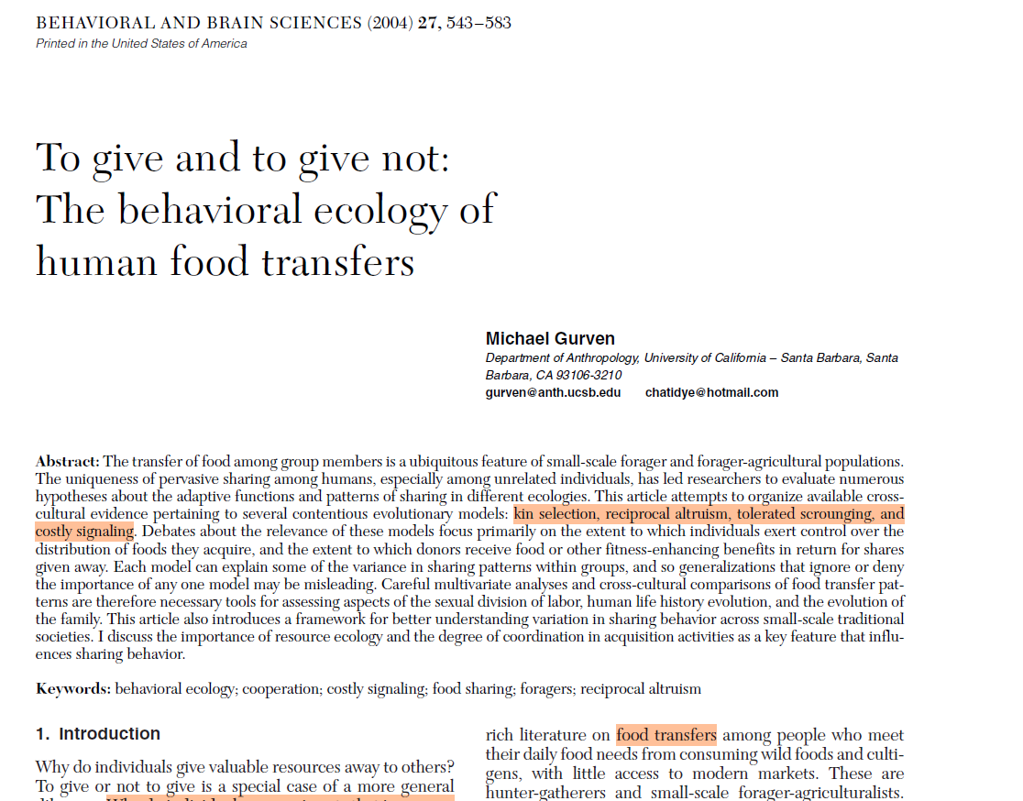
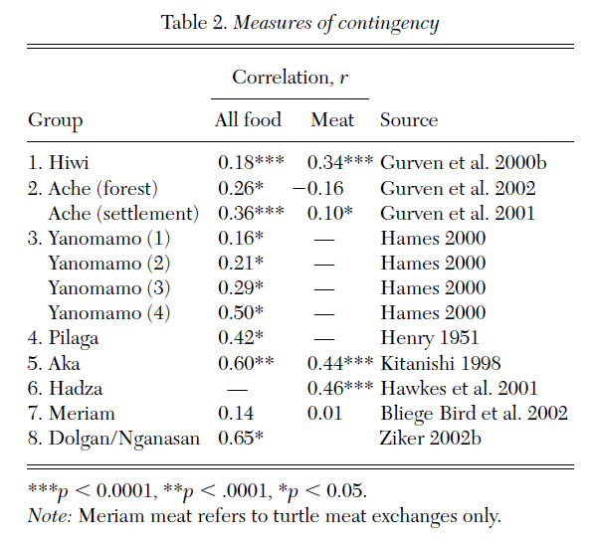

Slide 68
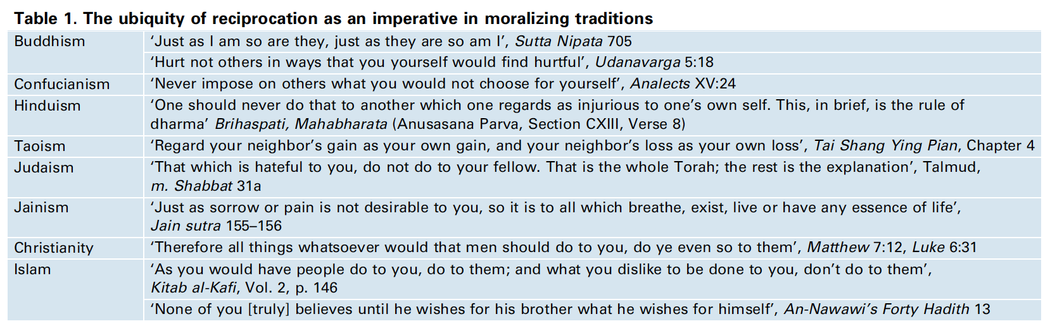
Reciprocity across cultures
Baumard & Boyer (2013). Explaining moral religions. Trends in Cognitive science.
Notes:
Natural selection is a competitive process

Slide 69
(i) Reciprocity is the social norm in all human societies
If a reciprocity is found in all human societies
this suggests that it is not only a cultural norm
but something that spontaneously emerges from
"human nature"
Curry et al. (2019). Is it good to cooperate? Testing the theory of morality-as-cooperation in 60 societies. Current Anthropology

Slide 70
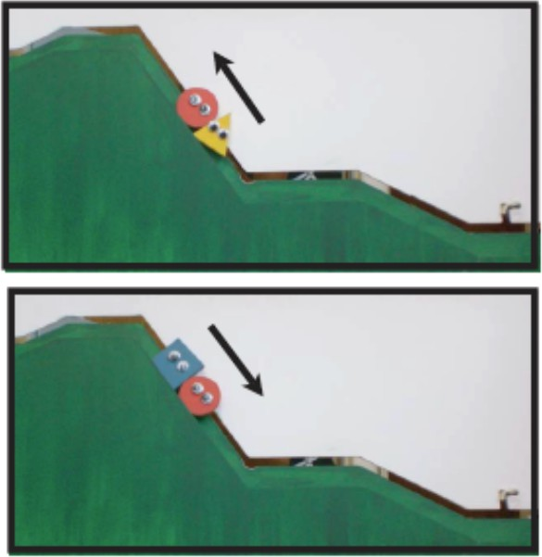
(ii) Children develop reciprocity-related intuitions even before they are fully socialized
6 & 10 month old children preferentially interact with cooperative puppets
https://www.youtube.com/ watch?v=anCaGBsBOxM
Hamlin, J. K., Wynn, K., & Bloom, P. (2007). Social evaluation by
preverbal infants. Nature.

Slide 71

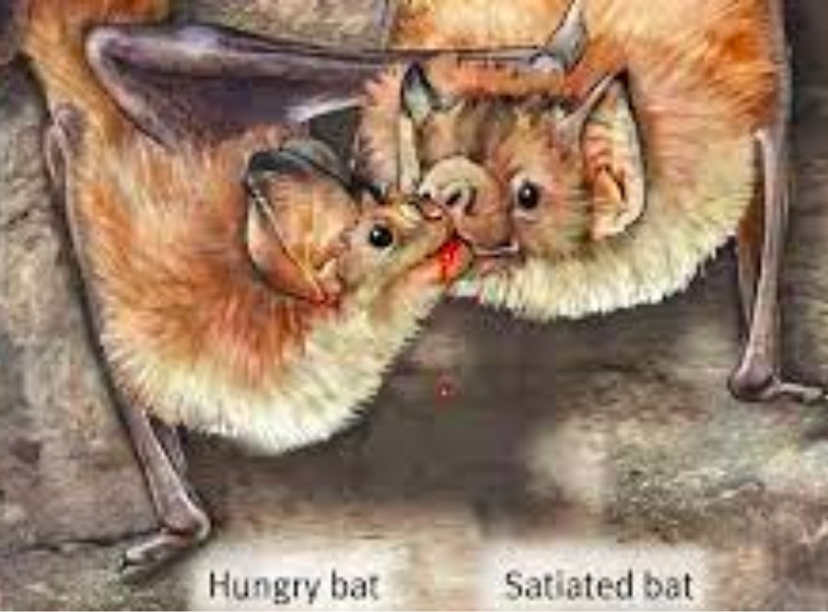
(iii) Reciprocity exists in other species that don't have culture
Carter, G. G., & Wilkinson, G. S. (2013). Food sharing in vampire bats: reciprocal help predicts donations more than relatedness or harassment. Proceedings of the Royal Society B.
Bshary, 2002; Bshary & Grutter, 2006

Slide 72
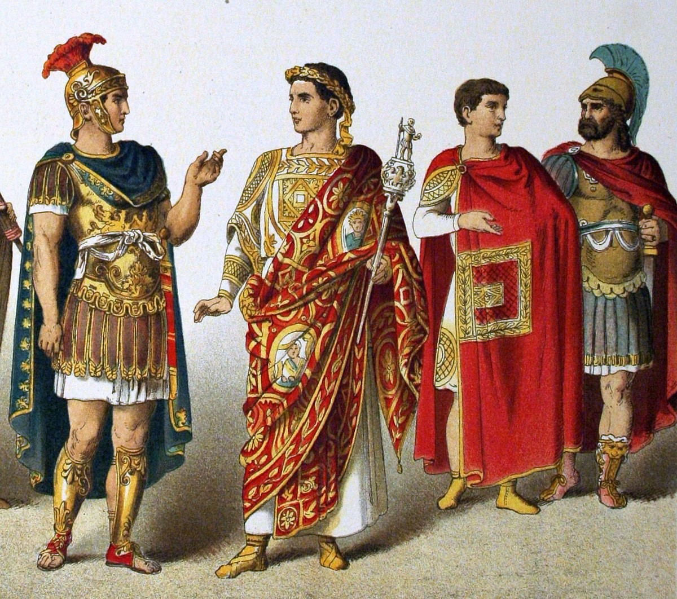
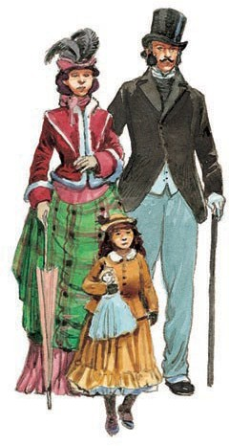
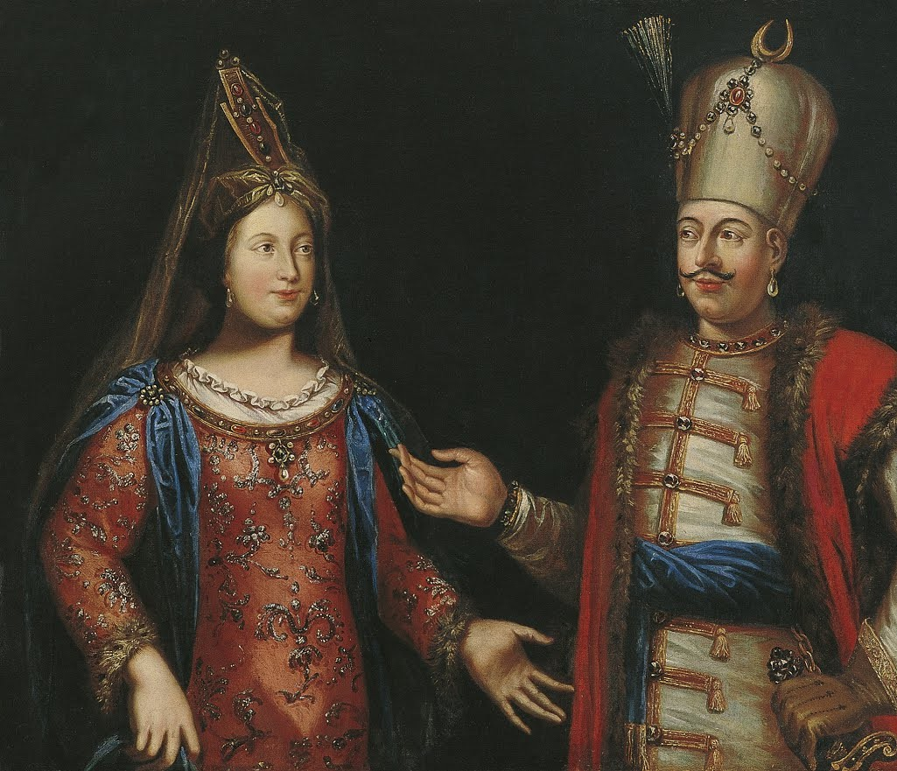
2nd problem: Why do cultural norms exhibit systematic relationship with certain environments?

Slide 73

Pierre Bourdieu, the habitus, and social classes
Bourdieu is known for the concept of habitus:
• = a deeply internalized and unconscious "way of being" that determines our perceptions, judgements, behaviors, values, and even body attitude
"principes générateurs et organisateurs de pratiques et de représentations qui peuvent être obįectivement adaptées à leur but sans supposer la visée consciente des fins et la maîtrise expresse des opérations nécessaires pour les atteindre, obįectivement « réglées » et « régulières » sans être en rien le produit de l’obéissance à des règles, et, étant tout cela, collectivement orchestrées sans être le produit de l’action organisatrice d’un chef d'orchestre"
The Emperor of French social science:
Pierre Bourdieu

Slide 74
Pierre Bourdieu, the habitus, and social classes
The habitus has 3 main characteristics:
It is acquired through socialization, esp. in the family
It is automatic, outside of conscious control
It is "embodied": it manifests through unconscious use of the body. the bourgeois learns to eat elegantly, the poor to speak loudly, women to move delicately, etc...
This makes the habitus seem perfectly
"natural" ("dans l'ordre des choses"), even though it is socially learned)
The Emperor of French social science:
Pierre Bourdieu

Slide 75
Pierre Bourdieu, the habitus, and social classes
Importantly, the habitus varies across social group, gender, etc. Here we'll focus on "class socialization".
Indeed, a social class is a "classe de conditions d’existence et de conditionnements identiques ou semblables".
Therefore, we should expect individuals of the same class to have very similar "habitus".
The Emperor of French social science:
Pierre Bourdieu

Slide 76

Pierre Bourdieu, the habitus, and social classes
Following Bourdieu, sociologists have frequently observed stark differences in upper class vs. working class habitus:
A "bourgeois habitus": values self-control and restraint (see Beatrix Le Wita, Ni vue, ni connue. Approche ethnographique de la culture bourgeoise, 1988)
A "working class habitus": values the defense of one's honor, a more normalized use of physical violence and aggressivity (see David Lepoutre, Coeur de banlieue, 1998).
Muriel Darmon, La Socialisation
In a cultural view, these differences in behavior are explained by the fact that people of different social classes internalize different habitus through socialization

Slide 77
Individual
Bourgeois behavior
(you act more self-controlled, you value restraint, you despise lack of control, people who laugh loudly, etc.)
Socialization
Bourgeois
habitus
Culture of the bourgeoisie
Cognit
Individual
working class behavior
(you act less self-controlled, you don't value restraint, you despise excessive control, people who are "uptight", etc.)
Socialization
Working class habitus
Culture of the working class
Cogni

Slide 78
But once again: why are clusters of norms associated in this way? (why is it not the other way around)
Why do we also observe these differences across different cultures?

Slide 79


Slide 80
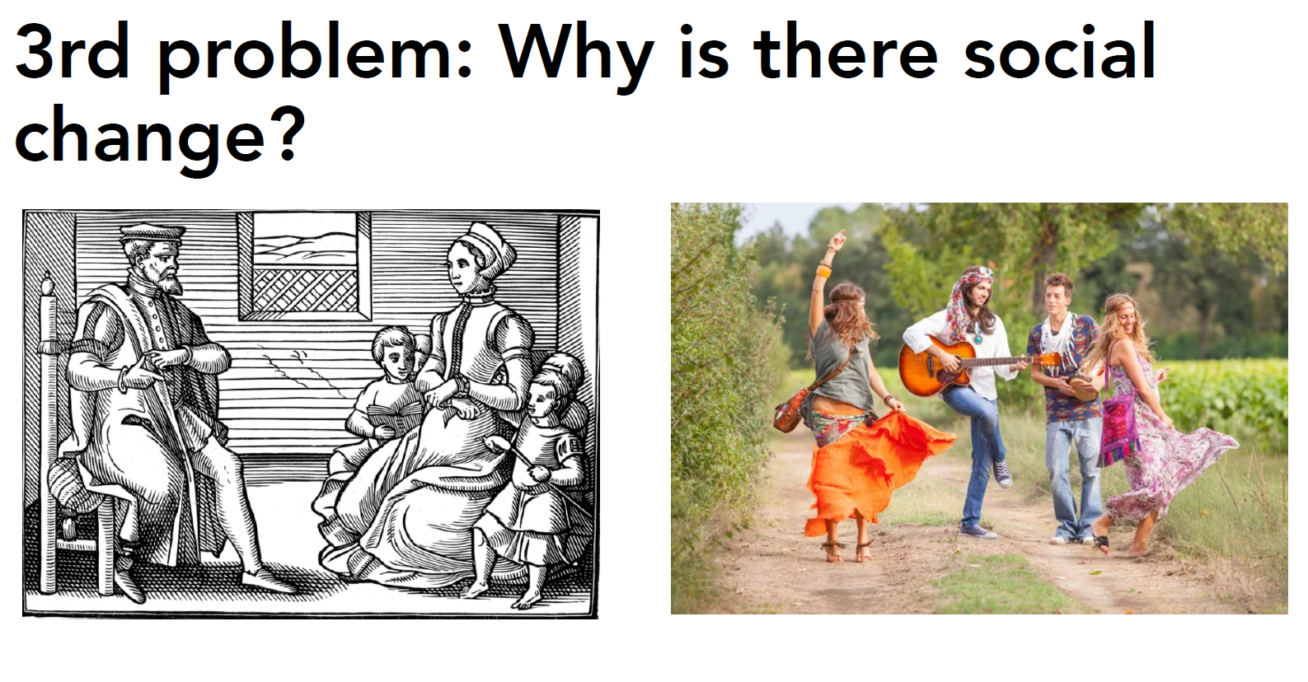

Slide 81
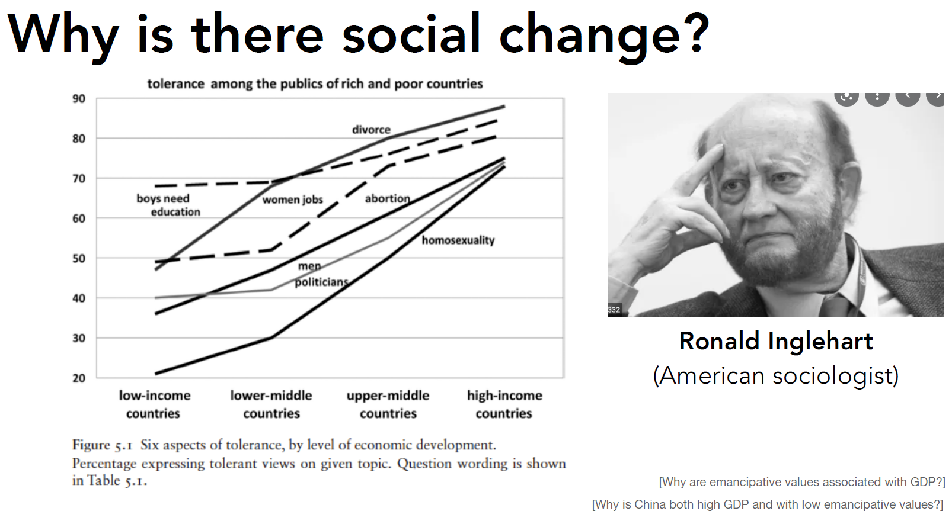

Slide 82
How to move beyond this debate?

Slide 83
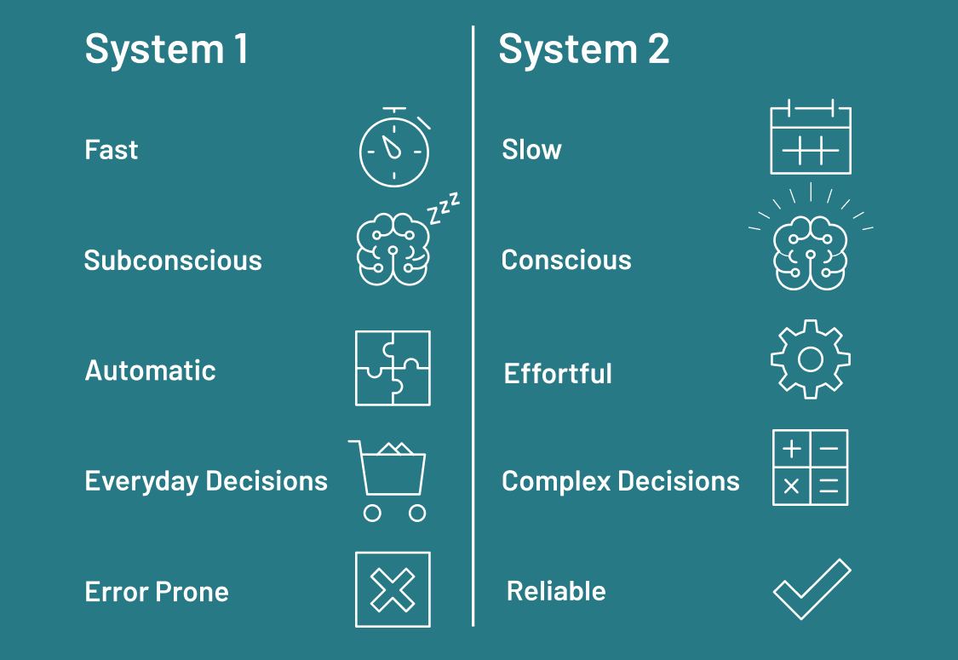

Slide 84
Systematic relationships between environment and behavior
Why do we also observe these differences across cultures?

Slide 85
Systematic relationships between environment and behavior
Why do we observe these differences across cultures?
"Cultural" models struggle to explain the systematic
relationship between environment and behavior
But some evolutionary/psychological models can explain it: deprived environments make short-term strategies more adaptive!

Slide 86
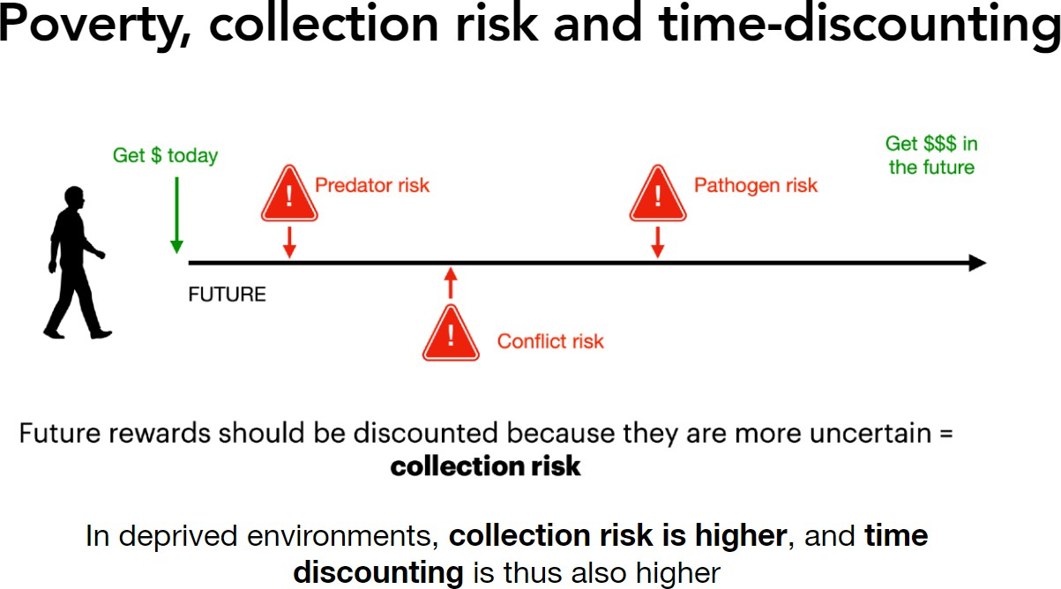

Slide 87
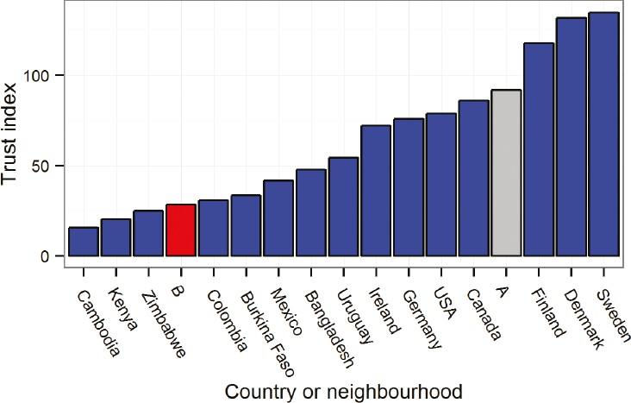
Socio-economic conditions, time-discounting and cooperation
Because cooperation is a long-term strategy we should observe a systematic
relationship between cooperation and socio-economic conditions
Again, something that is more difficult to explain with cultural approaches!

Slide 88
Boudieu himself switches to an "agentic" explanation when it comes to explaining these
differences!
"l'hédonisme qui porte à prendre au jour le jour les rares satisfactions ("les bons moments") du présent immédiat est la seule philosophie concevable pour ceux qui, comme on dit, n'ont pas d'avenir et qui ont en tout cas peu de choses à attendre de l'avenir.
On comprend mieux le matérialisme pratique qui se manifeste surtout dans le rapport aux nourritures soit une des composantes les plus fondamentales de l'ethos, voire de l'éthique populaire"
(Bourdieu, La Distinction, 1964)
This is exactly the same idea as the "collection risk" rationale we have seen

